Slide 1
Hybrid made easy.
Modernizing and moving to the cloud with Pivotal Cloud Foundry and AWS.
Ryan Niksch

Slide 2
Hybrid here to stay
Agility
Portability
Unified interface
Guard rails

Slide 3

https://aws.amazon.com/solutions/case-studies/news-liberty-mutual/

Slide 4

Pivotal and AWS better together.
Elasticity
Agility
Availability
$
Faster Time to Market
Infrastructure cost investment
Security

Slide 5
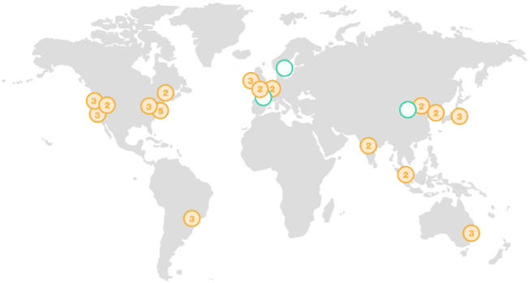
AWS Regions
AZ
Transit
Mesh of Availability Zones (AZ) and Transit Centers
Redundant paths to transit centers
Transit centers connect to:
Private links to other AWS regions
Private links to customers
Internet through peering & paid transit
AZs <2ms apart & usually <1ms
AZ
AZ
AZ
AZ
Transit

Slide 6
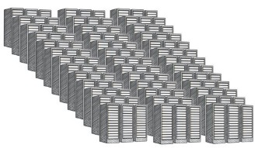
AWS Availability Zones
AZ
Transit
AZ
AZ
AZ
AZ
Transit
Regional cluster of discrete DCs
Separate redundant power, networking, connectivity and facility
All regions have 2 or more AZs
Each AZ is 1 or more DC
No data center is in two AZs
Some AZs have as many as 6 DCs
DCs in AZ less than ¼ ms apart
Data Center
Data Center
Data Center
Data Center

Slide 7
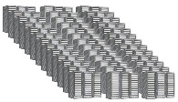
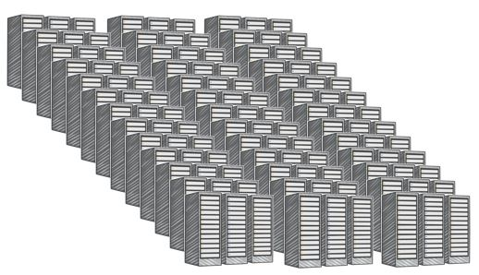
AWS Data Centers
Single DC typically over 50,000 servers & often over 80,000
Larger DCs undesirable to reduce blast radius

Slide 8
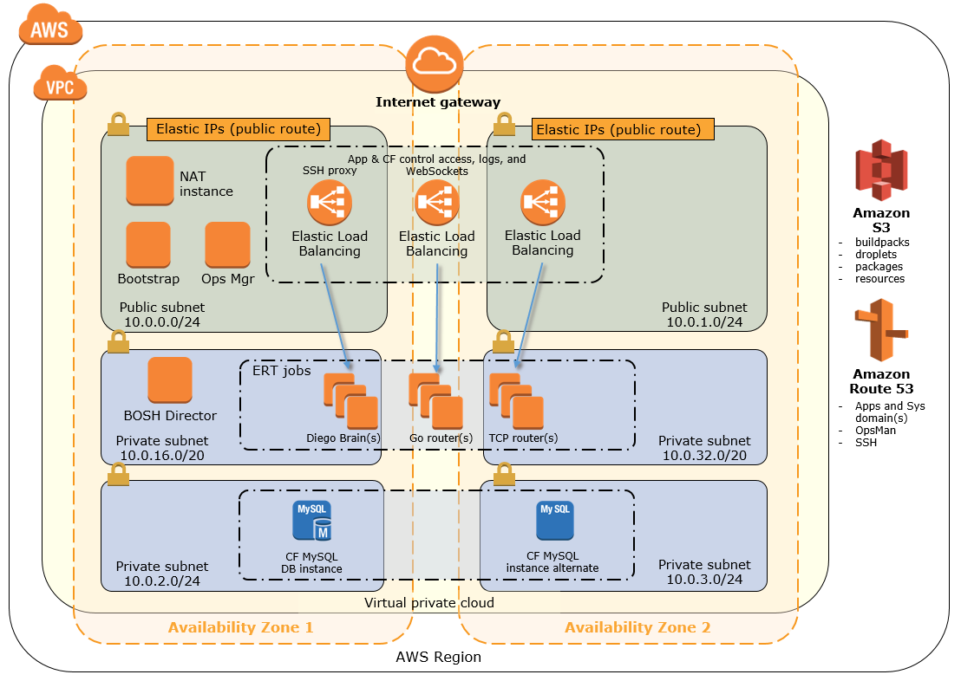
Up and Running now, right now!

Slide 9
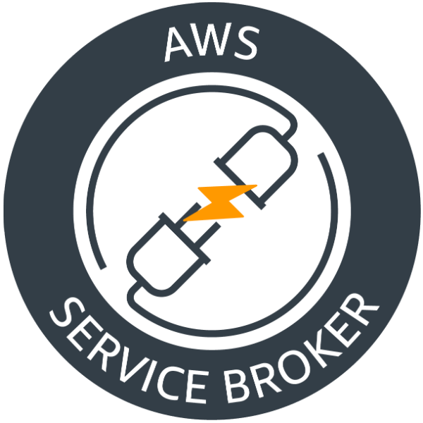














Amazon RDS
Postgres
Amazon RDS
MariaDB
AWS KMS
Amazon
Lex
Amazon S3
Amazon DynamoDB
Amazon EMR
Amazon Kinesis
Amazon SQS
Amazon SNS
Amazon Athena
Amazon Redshift
Amazon RDS
MySql
Amazon Route 53
Amazon
Polly
Amazon Rekognition

Slide 10


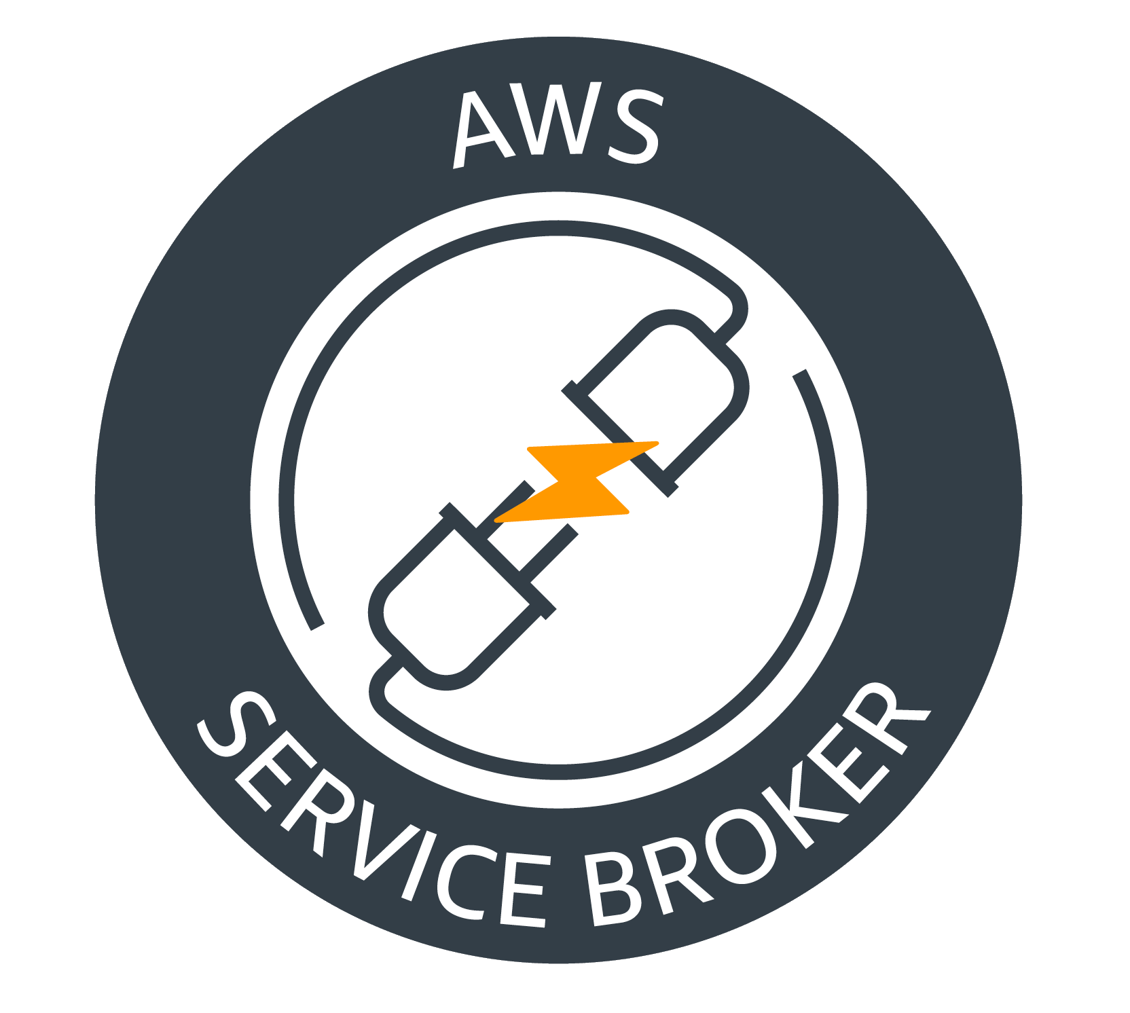

Provision and Bind
Application
Catalog/Marketplace
Create/Push
Provision
CreateStack
Create AWS Services
Application Created
Complete
CREATE_COMPLETE
AWS CloudFormation
Bind Service
Bind
DescribeStack/GetParameter
AWS CloudFormation
VCAP_SERVICES/Secret
Bind Credentials
Connection Information
Application Platform
AWS KMS
AWS cloud

Slide 11

Open Service Broker (OSB) API
Allows a broker to be consumed in multiple platforms, and provides application platforms with an easy way to implement a catalog.
Open API Specification https://github.com/openservicebrokerapi/servicebroker/
Catalog
Provision
Bind
Update
Unbind
Deprovision

Slide 12
Key Features
Multi-account provisioning
Configurable overrides
Private catalog
Portable
Stateless
Provisioning requires no AWS knowledge or account access
Best practice plans for Prod/Dev scenarios
Notes:
Talk over features

Slide 13
[Liberty quote] “Getting Pivotal Cloud Foundry up and running on Amazon Web Services was a breeze. Now, our path from developer laptop to production is hours, not weeks or months. Now, with the AWS Open Service Broker for PCF, we can take the next step, and easily add AWS services to our custom software. The service broker gives us a powerful, elegant way to interact with add-on services.”
Learn more about Liberty Mutual’s cloud native journey.
[MBIO quote] “Pivotal Cloud Foundry gives us a modern application platform for our most important business applications. Now, we can use the AWS Open Service Broker for PCF to make our apps better. With just a few commands, our developers can add bind their apps to over a dozen AWS services. This kind of convenience helps us go faster, and improve business outcomes with differentiated software.”
Learn more about Mercedes Benz and Pivotal.
Notes:
Talk over features

Slide 14



Standard RIs
These provide the most significant discount (up to 75% off On-Demand) and are best suited for steady-state usage.
Convertible RIs
These provide a discount (up to 54% off On-Demand) and the capability to change the attributes of the RI as long as the exchange results in the creation of Reserved Instances of equal or greater value. Like Standard RIs, Convertible RIs are best suited for steady-state usage.
Scheduled RIs
These are available to launch within the time windows you reserve. This option allows you to match your capacity reservation to a predictable recurring schedule that only requires a fraction of a day, a week, or a month.

Slide 15
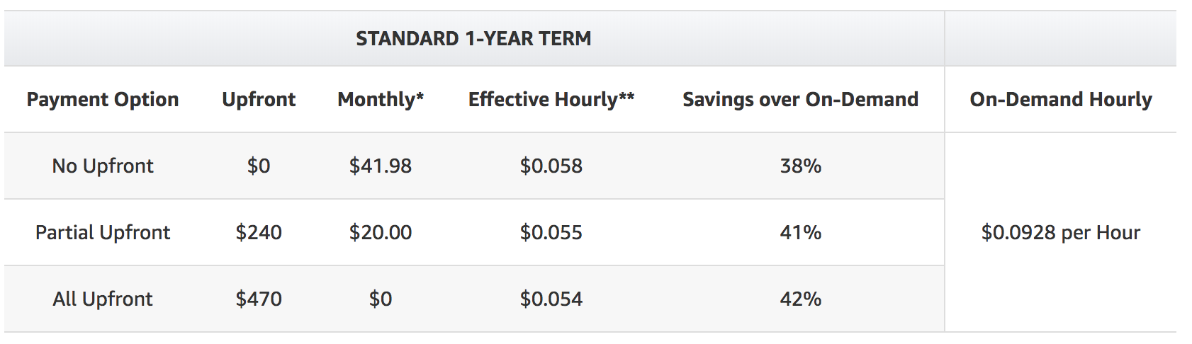
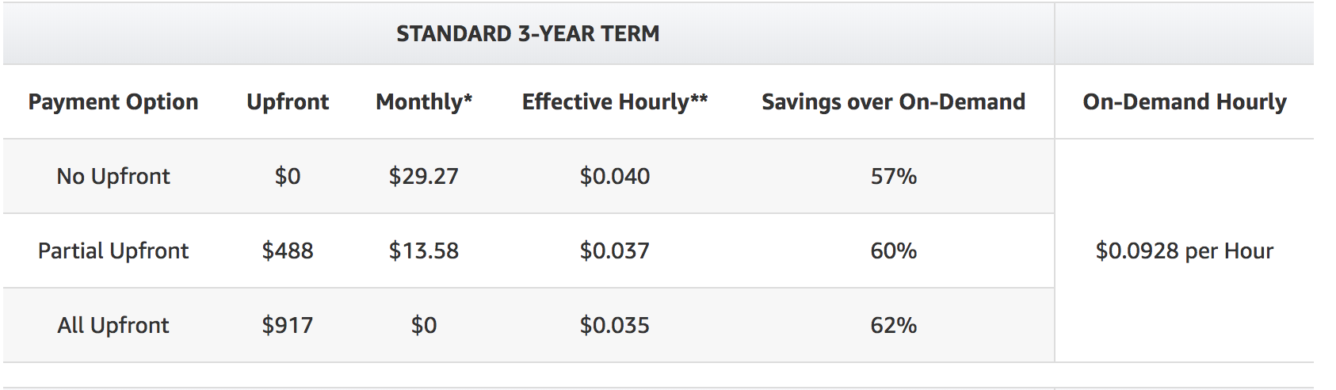
Reserved instances
No Upfront, Partial Upfront, All Upfront

Slide 16
Spot instances
resource_pools:
name: large_ondemand
cloud_properties:
availability_zone: eu-west-1a
instance_type: m2.xlarge
- name: large_spot
cloud_properties:
availability_zone: eu-west-1a
instance_type: m2.xlarge
spot_bid_price: 0.4

Slide 17
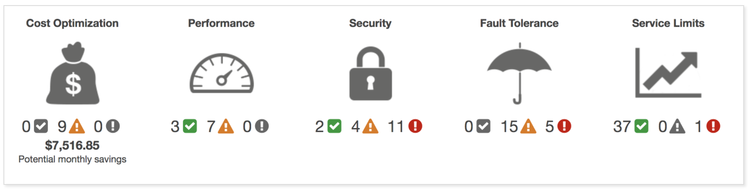
Trusted advisor
AWS Cost Explorer:
Monthly or daily.
Filter
Forecast
Grouping

Slide 18
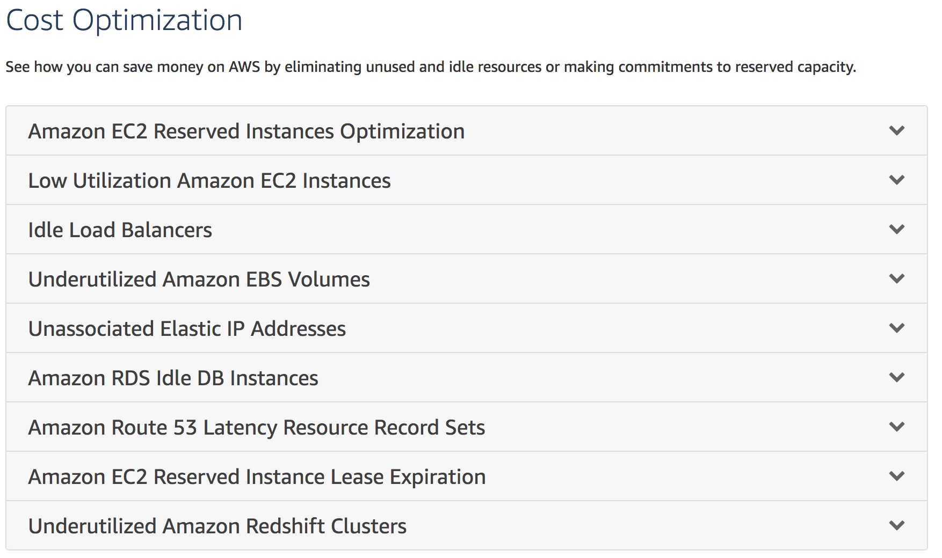

Slide 19
Working together to help you succeed.
POC
PROD

